Slide 1
ELEMENTARY STATISTICS, BLUMAN
Quartiles and Five Number Summary
© 2019 McGraw-Hill Education. All rights reserved. Authorized only for instructor use in the classroom. No reproduction or further distribution permitted without the prior written consent of McGraw-Hill Education.

Slide 2
Objectives for this PowerPoint
Find the Quartiles for a set of data
Find the Five Number Summary for a set of data

Slide 3
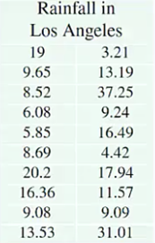
Rainfall Data
The July 1 to June 30 annual rainfall in Los Angeles for the years 1997 to 1998 through 2016 to 2017 is shown to the right.
The data values represent inches of rainfall.

Slide 4
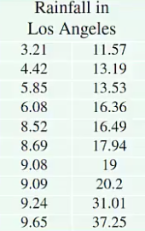
Minimum and Maximum Value
Let’s begin by finding the minimum data value the median and the maximum data value for this data set of 20 data values.
We can facilitate this process by first placing the data values in order.

Slide 5


Median
We can easily see that the minimum value is 3.21 and the maximum value is 37.25.
The median for an even-numbered set of data is the average of the middle two values once the data set is ordered.
We can find the median by adding 9.65 and 11.57 and dividing by 2.
$$Med=\frac{9.65+11.57}{2}=10.61$$

Slide 6
Quartiles
Let’s continue our analysis of this data set by finding the quartiles. The quartiles divide the data set into four equal parts.

Slide 7
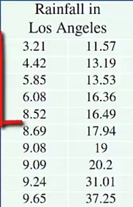
Q₁
The first quartile which is abbreviated Q₁ separates the bottom 25% of the data set from the top 75%.

Slide 8
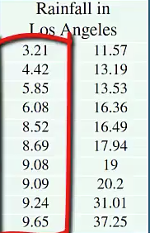
Q₂
The second quartile separates the bottom 50% of the data set and the top 50%.
This is also the median for the data set.

Slide 9
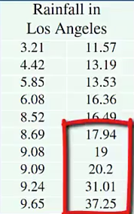
Q₃
The third quartile separates the bottom 75% of the data set from the top 25%.

Slide 10
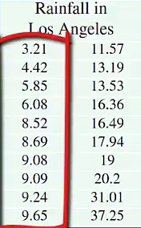

Find Q₁
The 1st quartile is determined by finding the median of the values that fall below the median for the data set.
There are 10 values in the bottom 50% of the data set. The first quartile will be found by adding 8.52 and 8.69 and dividing by 2.
$$Q1=\frac{8.52+8.69}{2}=8.605$$

Slide 11
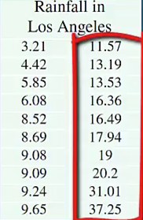

Find Q₃
The 3rd quartile is found by determining the median for the top 50% of the data set.
We will find this value by adding 16.49 and 17.94 and dividing by 2.
$$Q3=\frac{16.49+17.94}{2}=17.215$$

Slide 12
Five Number Summary
We now have a list of five measures that are resistant to extreme data values.
List of five values:
Minimum
1st Quartile
Median
3rd Quartile
Maximum
These five values are called the Five Number Summary.

Slide 13
Summary
In this PowerPoint we learned how to find the quartiles for a data set and how to find the Five Number Summary for a data set.

